Slide 1
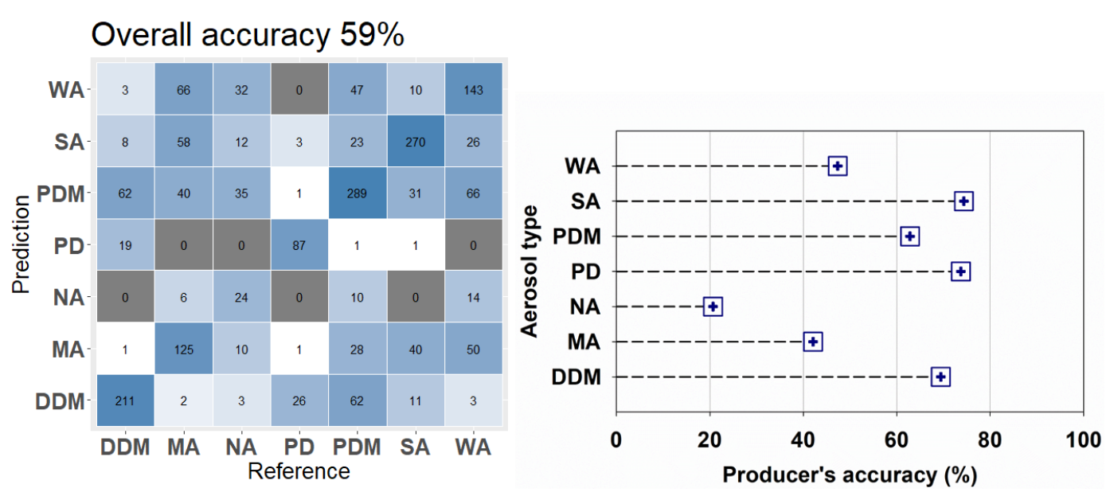
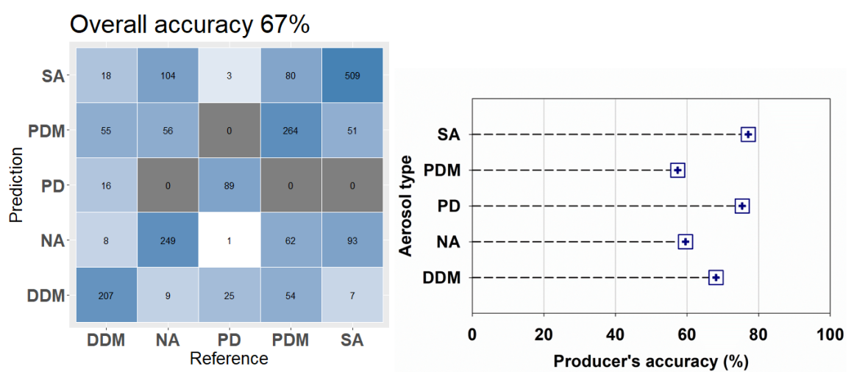
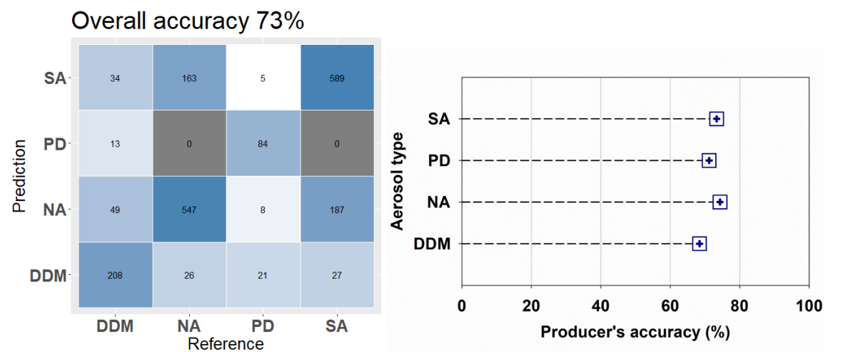
Development and evaluation of a machine learning-based aerosol type classification algorithm using satellite and AERONET data
W. choi¹, H. Lee², and G. Lee²
1. Department of Spatial Information Engineering
2. NASA Goddard Space Flight Center
Abstract
The aerosol type information is important due to its significance on the aerosol radiative forcing calculations and aerosol source identification. In this present study, we, for the first time, utilized a random forest machine learning model that uses both MODIS and TROPOMI data and AERONET aerosol type data as the inputs to classify aerosols into seven distinct categories: pure dust, dust-dominant mixed, pollution-dominant mixed aerosols, and pollution aerosols (strongly, moderately, weakly, and non-absorbing). The performance of aerosol classification model was evaluated via the comparison with the AERONET data that were not included in the training set. Our a machine learning based aerosol classification model showed better performance than previous satellite aerosol classification methods that employed similar input variables. Specifically, our model's accuracy reached 59% for categorizing into the seven types. However, when categorized into four groups—pure dust, dust-dominant mixed, strongly absorbing, and non-absorbing—the accuracy significantly improved to 72%. This present study highlights the effectiveness of machine learning method in classifying satellite aerosols, particularly their sensitivity to non-spherical particles.
Method
Results
Flow chart
Model accuracy
AERONET
Measurement data
Aerosol classification
(Shin et al., 2019)
Input variable dataset
Target variable dataset
Satellite-based
Measurement data
Aerosol type
Machine learning approach
(Random Forest)
Aerosol type
Accuracy assessment
Type name | Aerosol type
PD | Pure Dust
DDM | Dust Dominated Mixture
PDM | Pollution Dominated Mixture
NA | Non-Absorbing
WA | Weakly Absorbing
MA | Moderately Absorbing
SA | Strongly Absorbing
Input data
Sensor (Misson) | Aerosol type | Variable | Notes
TROPOMI (Sentinel-5P) | AI (L2) | Aerosol index | A qualitative measure indication the presence of absorbing aerosols
 |  | Solar Zenith angle | The angle between the zenith and the sun
DDM | CO (L2) | CO column amount | The number of molecules of CO from the surface to top of the troposphere per unit area
PDM | NO2 (L2) | Tropospheric NO2 column density | The number of molecules of NO2 from the surface to top of the troposphere per unit area
MODIS (Aqua) | MYD04 (L2) | Aerosol optical depth | A measure of the extinction of the solar radiance by aerosols
WA |  | ÅngstrÖm exponent | A power law relationship with AOD An indicator of particle size
MA |  | TOA reflectance (ddeep blue; 412, 470 and 660 nm) | A ratio of reflected radiance to the incident solar radiance
SA | MCD12C1 (L3) | Land cover type | Major land cover type among land classes (annual)
 |  | Percent of urban area | A ratio of urban area (annual)
When aerosols were classified into seven types, the overall accuracy of the RF-based model was 59%. The model demonstrated reliable detection accuracies for the SA (74%), PD (74%), and DDM (69%) types, indicating strong sensitivity to dust and pollution particles with high absorption. However, the detection performance for pollution aerosols such as MA, WA, and NA was generally below 47%, with the NA type classification accuracy particularly low at 21%. By consolidating the aerosols into five types (PD, DDM, PDM, SA, and NA), our RF-based model showed improved detection performance, achieving an overall accuracy of 67%. Further improvement was achieved by merging the aerosol classes into four types (PD, DDM, NA [e.g., sulfate and nitrate], and SA [e.g., carbonaceous aerosols]), which resulted in an overall accuracy of up to 73%.
Conclusion
We propose a new method for the identification of aerosol types using an RF model—a machine learning technique. The RF-based model was trained using an AERONET-based aerosol type dataset using MODIS and TROPOMI satellite input-variable datasets. Previous and new satellite input variables were adopted in the RF model, and their importance was investigated. The aerosol index, AOD, SZA, and the column amount of trace gases were found to make substantial contributions to the RF aerosol classification model. The performance of the RF-based model was evaluated using AERONET-based aerosol data and compared with that of previous satellite aerosol classification methods, which use empirically calculated threshold values. Our RF-based model was found to have generally better performance than the previous methods. Therefore, our RF-based model can identify aerosols of up to seven types, with more aerosol types and greater accuracy than in previous studies that use input variables similar to those of this study. The performance of our RF-based model was improved by merging aerosol classes into four types (PD, DDM, NA [e.g., sulfate and nitrate], and SA [e.g., carbonaceous aerosols]). This merging of aerosol types improved aerosol classification accuracy, with the RF-based method (using satellite variables) having limitations in detailing aerosol compositions.
Notes:
연구자료에 < 학습 데이터 : 2019.10.31 / 검증 데이터 : 2019.10.31 이후 수집되는 교통사고 데이터 > 추가하기

